Slide 1
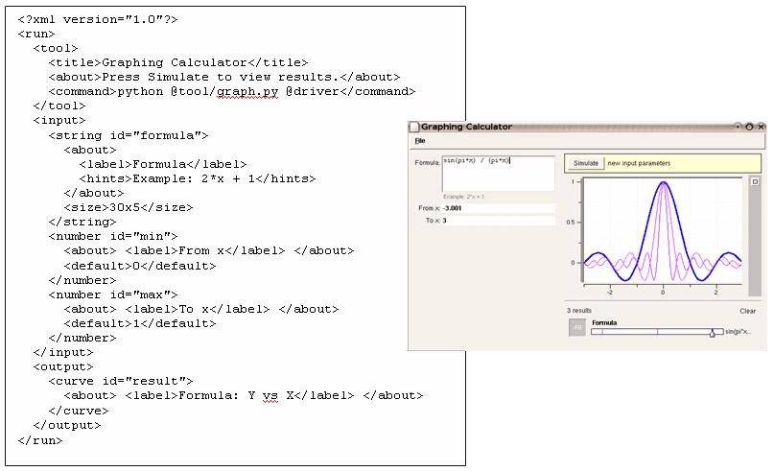

Rappture with Fortran
Michael McLennan
HUBzero® Platform for Scientific Collaboration
Purdue University
This work licensed under
Creative Commons
See license online:
by-nc-sa/3.0

Slide 2
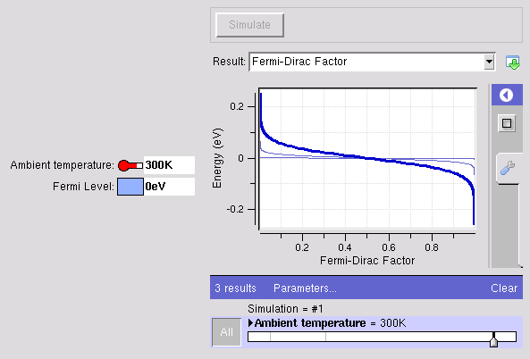
Example: app-fermi in Fortran
The usual way…
The Rappture way…
% gfortran fermi.f -o fermi
% ./fermi
Enter the Fermi level (eV):
2.4
Enter the temperature (K):
77
% more out.dat
FERMI-DIRAC FUNCTION F1/2
f1/2 Energy (eV)
------------ ------------
0.999955 2.33365
0.99995 2.33431
0.999944 2.33498
https://nanohub.org/infrastructure/rappture
source code: rappture/examples/app-fermi

Slide 3
What is the interface?
fermi.f
program fermi
write(6,*) ‘Fermi energy in eV:’
read(5,*) Ef
write(6,*) ‘Temperature in K:’
read(5,*) T
kT = 8.61734e-5 * T
Emin = Ef - 10*kT
Emax = Ef + 10*kT
dE = 0.005*(Emax - Emin)
do 10 E=Emin,Emax,dE
f = 1.0/(1.0+exp((E-Ef)/kT))
write(6,*) f, E
10 continue
end program fermi
Inputs/outputs are
identical to the
MATLAB version
number
number
physics
curve

Slide 4
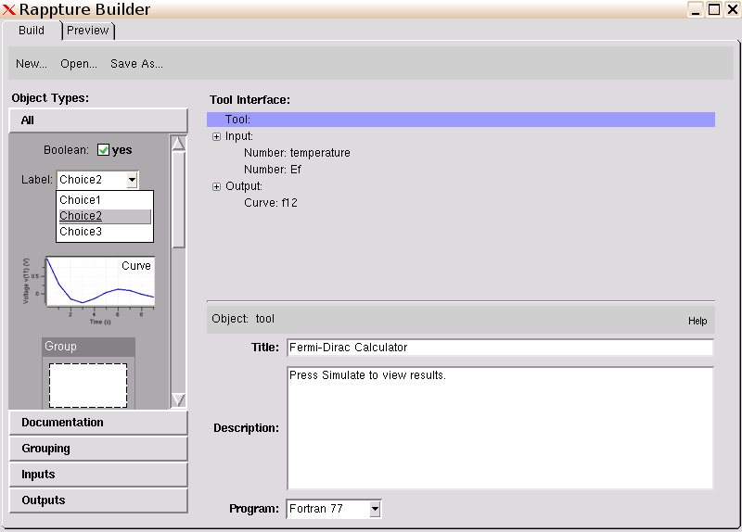
Same interface – Use Fortran
Change this

Slide 5
Add physics to the generated code
Generated program: main.f
…
c get input value for input.number(temperature) and convert to K
call rp_lib_get(io,
+ "input.number(temperature).current", strVal)
ok = rp_units_convert_dbl(strVal,"K",temperature)
c get input value for input.number(Ef) and convert to eV
call rp_lib_get(io,
+ "input.number(Ef).current", strVal)
ok = rp_units_convert_dbl(strVal,"eV",Ef)
c ----------------------------------------------------------
c Add your code here for the main body of your program
c ----------------------------------------------------------
c save output value for output.curve(f12)
c this shows just one (x,y) point -- modify as needed
write(strVal,'(E20.12,E20.12,A)') x, y, char(10)
call rp_lib_put_str(io,
+ "output.curve(f12).component.xy",strVal,1)
call rp_result(io)
end program main
kT = 8.61734e-5 * T
Emin = Ef - 10*kT
Emax = Ef + 10*kT
dE = 0.005*(Emax - Emin)
do 10 E=Emin,Emax,dE
f = 1.0/(1.0+exp((E-Ef)/kT))
physics

Slide 6
Add physics to the generated code
Generated program: main.f
…
c get input value for input.number(temperature) and convert to K
call rp_lib_get(io,
+ "input.number(temperature).current", strVal)
ok = rp_units_convert_dbl(strVal,"K",temperature)
c get input value for input.number(Ef) and convert to eV
call rp_lib_get(io,
+ "input.number(Ef).current", strVal)
ok = rp_units_convert_dbl(strVal,"eV",Ef)
kT = 8.61734e-5 * temperature
Emin = Ef - 10*kT
Emax = Ef + 10*kT
dE = 0.005*(Emax - Emin)
do 10 E=Emin,Emax,dE
f = 1.0/(1.0+exp((E-Ef)/kT))
c save output value for output.curve(f12)
write(strVal,'(E20.12,E20.12,A)') f, E, char(10)
call rp_lib_put_str(io,
+ "output.curve(f12).component.xy",strVal,1)
10 continue
…

Slide 7
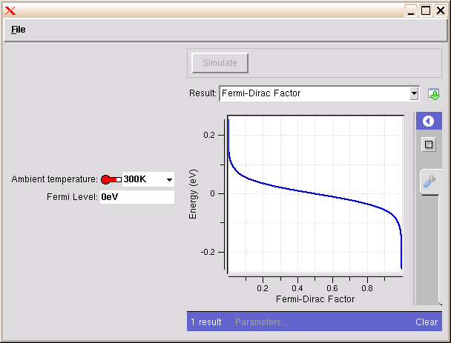
Build the program
Don’t forget to “make” the program!
% make
gfortran -g -Wall -I/apps/rappture/20110405
/include main.f -o mainf77 -L/apps/rappture
/20110405/lib -lrappture -lm
% ls
Makefile tool.xml main.f mainf77
% rappture

Slide 8

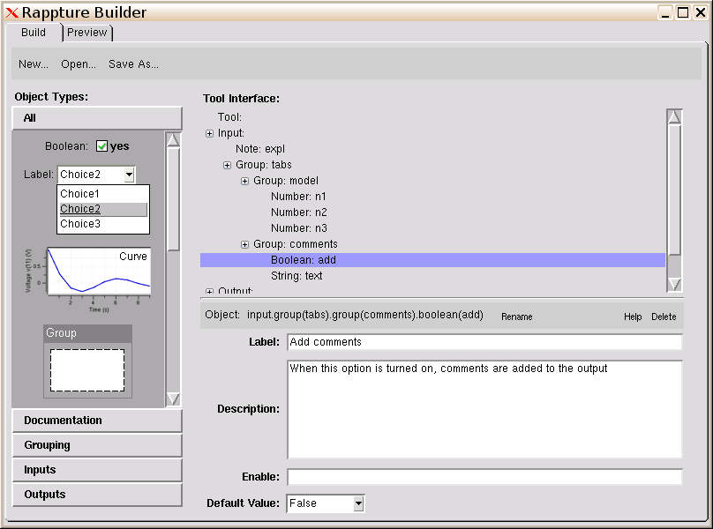
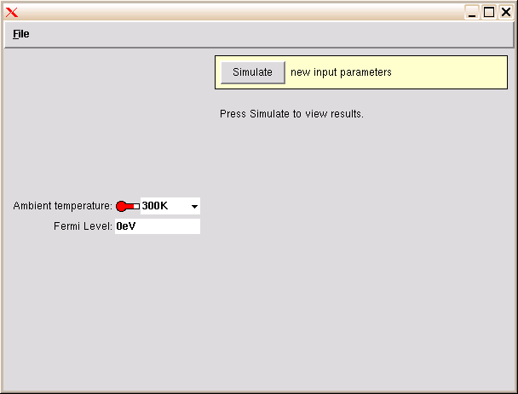
Running the code
Builder
Runner
<XML>
driver1827.xml
kT = 8.61734e-5 * T
Emin = Ef - 10*kT
Emax = Ef + 10*kT
dE = 0.005*(Emax - Emin)
do 10 E=Emin,Emax,dE
f = 1.0/(1.0+exp((E-Ef)/kT))
10 continue
<?xml version="1.0"?>
<run>
…
<output>
<curve id="f12">
…
<component>
<xy>
0.999955 2.33365
0.99995 2.33431
0.999944 2.33498
…
</output>
</run>
physics
<XML>
<XML>
tool.xml
run12703129102.xml

Slide 9

How your program gets invoked
<?xml version="1.0"?>
<run>
<tool>
<about>Press Simulate to view results.</about>
<command>@tool/mainf77 @driver</command>
</tool>
<input>
…
<XML>
tool.xml
/apps/yourtool/current/mainf77 driver327.xml
program main
IMPLICIT NONE
…
c open the XML file containing the run parameters
call getarg(1,inFile)
io = rp_lib(inFile)
if (io .eq. 0) then
write(6,*) "FAILED loading Rappture data”
…
Rappture
call rp_lib_put_str(io,
+ "output.curve(f12).component.xy",strVal,1)
10 continue
call rp_result(io)
end program main

Slide 10

Not Much Overhead
It’s easy to add Rappture to your new tools:
Instead of this…
Do this…
<number id="Ef">
<about>
<label>Fermi Level</label>
</about>
<units>eV</units>
<default>0eV</default>
</number>
Documentation
read(5,*) Ef
call rp_lib_get(driver, path, str)
ok = rp_units_convert_dbl(str, “eV”, Ef)
call rp_lib_put_str(driver, path, val, 0)
…
rp_result(driver)
write(6,*) Ef

Slide 11
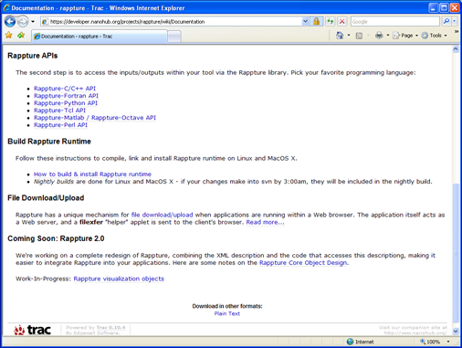
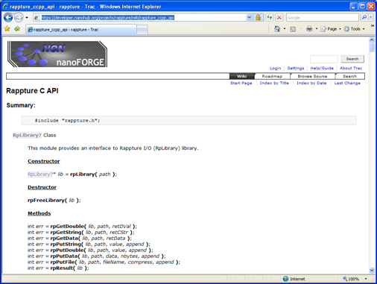
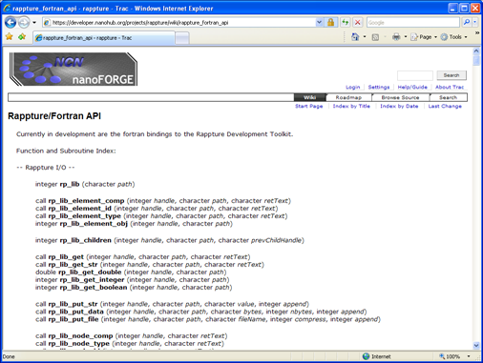
Reference Documentation
http://rappture.org
Documentation
Rappture-Fortran API
Examples:
app-fermi in Fortran

